Slide 1
Why Pensions

Slide 2
Pension Timebomb
Increasing, wealthier population
Quality of life now key – pre & post retirement
How will increased population (your client) provide for their retirement?
What State Pension / Benefits will be available in the future?

Slide 3
pensions
Can you rely on the State Pension only ?
Retirement Old Age Contributory Pension 2009
Personal Rate
€230.30 (€11,976 p.a.)
Personal + Adult dependant (over 66)
€436.60 (€22,703 p.a.)
Average Industrial Wage €730 (€38,000 p.a.)

Slide 4
Drop in income if relying solely on State Pension
Current Income
€38,000
€60,000
€80,000
42%
64%
72%
71%
81%
85%
If Single
If Dependent Spouse

Slide 5
People are living much longer in retirement
Life Expectancy
From
age 60
MALE
22 years
FEMALE
27 years
From
age 65
18 years
22 years
14 years
From
age 70
18 years
0
5
10
15
20
25
30

Slide 6
Replacing your income - % of salary needed
The cost of delay
102%
62%
43%
32%
24%
15%
19%
Age
Now
25
30
35
40
45
50
55
65
Targeting 67% of salary at age 65

Slide 7
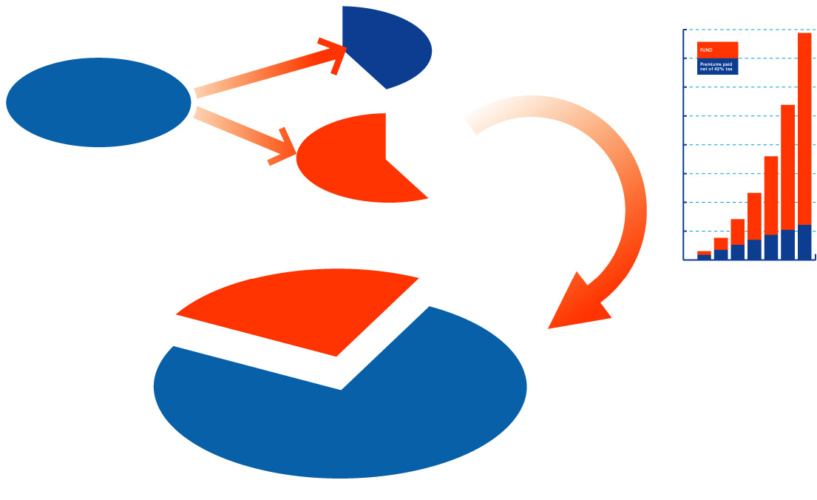

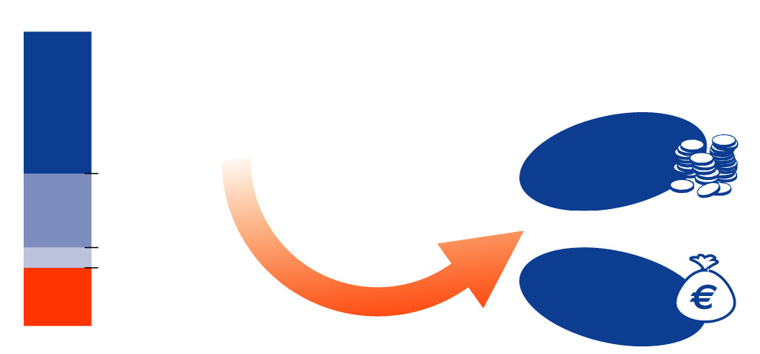
the tax-efficient way to save
pensions
Cost to
the Gov
YOU GET FULL TAX RELIEF
Cost to
the Gov
GROWS
TAX-FREE
€420
€470
€1,000
invested
€1,000
invested
Cost to
you
Cost to
you
€580
You get full tax relief of 41%
and PRSI relief of 6%
€530
25%
can be taken TAX-FREE
AT RETIREMENT YOU HAVE A LARGE LUMP SUM
Take an
income
The other 75% is TAXABLE
OR
Take
the cash
Unless you have a guaranteed income of
€12,700, €63,500 of your fund
must be invested into an approved minimum retirement fund
*Tax relief is limited to contributions which are based on a percentage of your salary dependent on your age. The tax rate quoted is the top rate for the year 2003. You must be eligible to take out a pension in order to claim relief.

Slide 8
I will get around to it later ….?
Every 5 years you delay taking out a pension -
You can either double the premium or halve the fund ……
An Example ……

Slide 9


The Benefit of Compounding – Starting Early
Paddy the Plasterer
Invests €2,000 per month from age 18 to 26 then stops
Dr Gray from Gray’s Anatomy
Invests €2,000 per month from age 26 to 65
Who has the biggest fund at 65?

Slide 10
The Benefit of Compounding – Starting Early
Value at 65 €944,641
Less contributions € 14,000
Net profit €930,641
Paddy’s investment grew 66 fold
Value at 65 €973,704
Less contributions € 80,000
Net profit €893,704
Dr Gray’s investment grew 11 fold
Assuming an average yearly return of 10% p.a.

Slide 11

How much should
you save ?
How much income do you want to retire on ?
State Pension of
  €11,611 (single)
  €22,011(with adult dependant)
How much would it cost to provide an additional income of €10,000 a year (in today’s terms) from age 65 ?

Slide 12
MALE - €10,000 pa income at age 65
Net cost based on income tax relief of 20% (A) and 41% (B)
Current Age
Gross
(A)
Net
(B)
25
€185 pm
€137 pm
€98 pm
30
€233 pm
€172 pm
€124 pm
35
€301 pm
€223 pm
€160 pm
40
€396 pm
€293 pm
€210 pm
45
€529 pm
€392 pm
€280 pm
50
€754 pm
€558 pm
€400 pm
* Assumes an investment return of 6% a year, premiums indexing at 5% a year and inflation of 3% a
year. Income in retirement also indexes at 3% a year. PRSI relief on contributions of 6% also assumed.

Slide 13
FEMALE - €10,000 pa income at age 65
Net cost based on income tax relief of 20% (A) and 41% (B)
Current Age
Gross
(A)
Net
(B)
25
€205 pm
€152 pm
€108 pm
30
€259 pm
€192 pm
€137 pm
35
€334 pm
€248 pm
€177 pm
40
€440 pm
€325 pm
€233 pm
45
€588 pm
€435 pm
€312 pm
50
€839 pm
€621 pm
€445 pm
* Assumes an investment return of 6% a year, premiums indexing at 5% a year and inflation of 3% a
year. Income in retirement also indexes at 3% a year. PRSI relief on contributions of 6% also assumed.

Slide 14

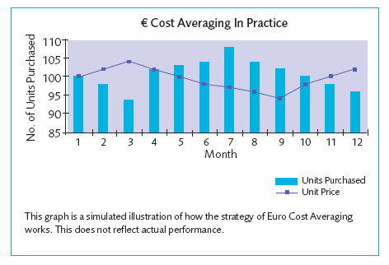
Take advantage of € cost averaging
By investing at regular intervals more units are purchased when unit prices (stock markets) are low and fewer units are purchased when prices are high.

Slide 15
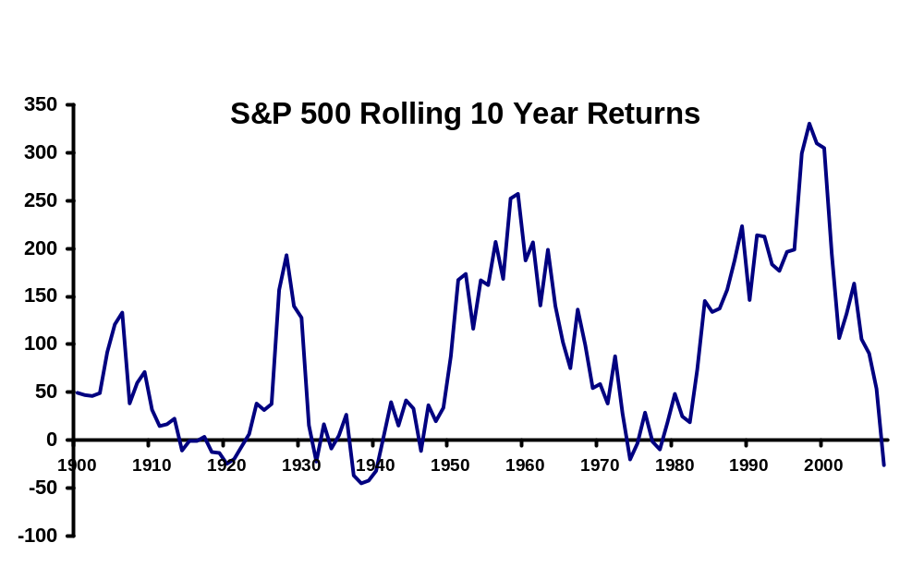
30 Year Stock Market Cycles
Since the early 1900’s markets have tended to move in 30 year cycles

Slide 16
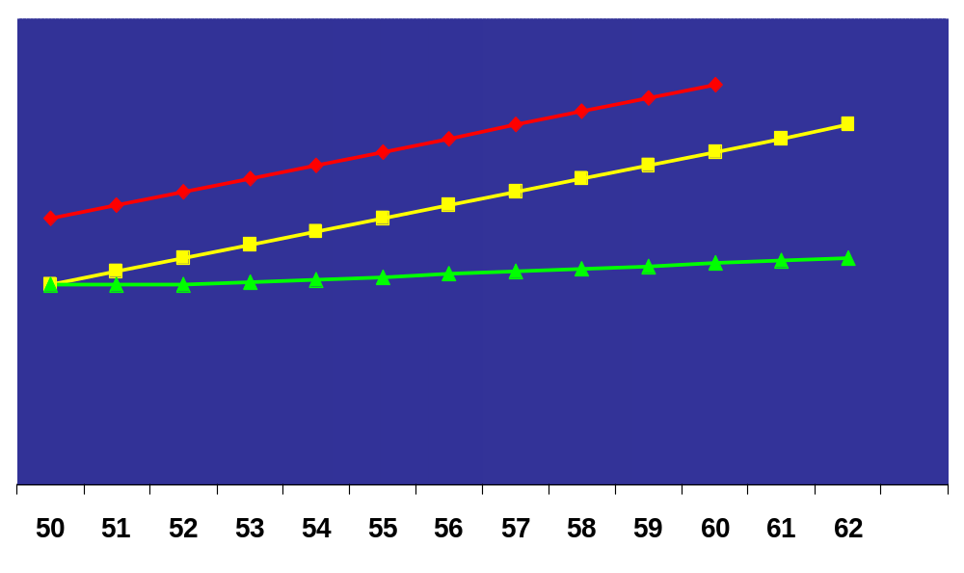
Can the dream be realised?*
100%
No
Excess
Growth /
Payment
87%
FUND
Before
Stay invested and keep paying
- 30%
44%
PUP + cash
AGE
*€1000 per month; existing fund 400k; 10 years to retirement; Managed Fund @ 6% pa; Cash Fund @ 3% pa

Slide 17
In Summary
Cannot afford to live on the state pension
Can the state afford to provide … over 70’s medical card etc ….
People are living longer … but their standard of living is decreasing in retirement
The earlier you start – the bigger the fund
Advantages of buying cheap units in the current environment
Tax relief – up to 50% tax -better than SSIA’s

